Slide 1
William Stallings
Data and Computer Communications
7th Edition
Chapter 18
Internet Protocols

Slide 2
Protocol Functions
Small set of functions that form basis of all protocols
Not all protocols have all functions
  Reduce duplication of effort
  May have same type of function in protocols at different levels
Encapsulation
Fragmentation and reassembly
Connection control
Ordered delivery
Flow control
Error control
Addressing
Multiplexing
Transmission services

Slide 3
Encapsulation
Data usually transferred in blocks
  Protocol data units (PDUs)
  Each PDU contains data and control information
  Some PDUs only control
Three categories of control
Address
  Of sender and/or receiver
Error-detecting code
  E.g. frame check sequence
Protocol control
  Additional information to implement protocol functions
Addition of control information to data is encapsulation
Data accepted or generated by entity and encapsulated into PDU
  Containing data plus control information
  e.g. TFTP, HDLC, frame relay, ATM, AAL5 (Figure 11.15), LLC, IEEE 802.3, IEEE 802.11

Slide 4
Fragmentation and Reassembly
(Segmentation – OSI)
Exchange data between two entities
Characterized as sequence of PDUs of some bounded size
  Application level message
Lower-level protocols may need to break data up into smaller blocks
Communications network may only accept blocks of up to a certain size
  ATM 53 octets
  Ethernet 1526 octets
More efficient error control
  Smaller retransmission
Fairer
  Prevent station monopolizing medium
Smaller buffers
Provision of checkpoint and restart/recovery operations

Slide 5
Disadvantages of Fragmentation
Make PDUs as large as possible because
  PDU contains some control information
  Smaller block, larger overhead
PDU arrival generates interrupt
  Smaller blocks, more interrupts
More time processing smaller, more numerous PDUs

Slide 6
Reassembly
Segmented data must be reassembled into messages
More complex if PDUs out of order

Slide 7
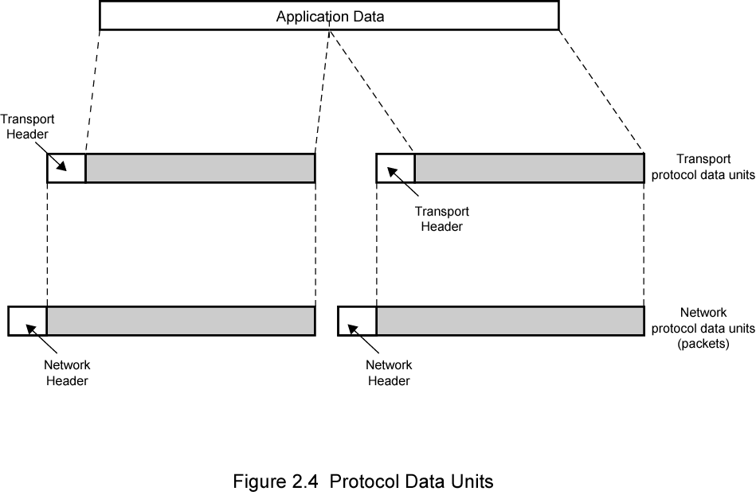
PDUS and Fragmentation
(Copied from chapter 2 fig 2.4)

Slide 8
Connection Control
Connectionless data transfer
  Each PDU treated independently
  E.g. datagram
Connection-oriented data transfer
  E.g. virtual circuit
Connection-oriented preferred (even required) for lengthy exchange of data
Or if protocol details must be worked out dynamically
Logical association, or connection, established between entities
Three phases occur
  Connection establishment
  Data transfer
  Connection termination
  May be interrupt and recovery phases to handle errors

Slide 9
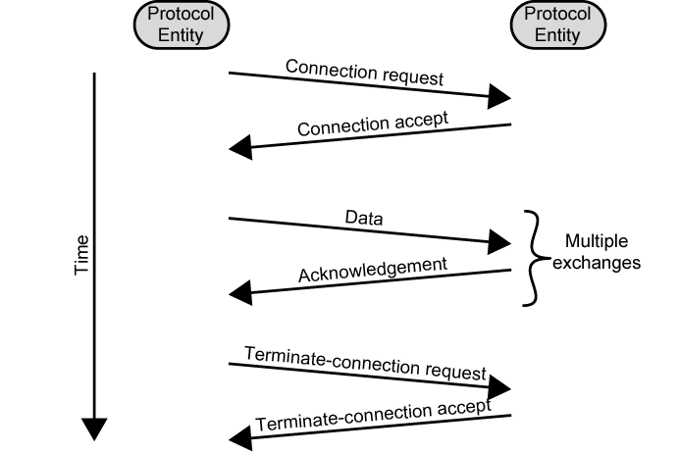
Phases of Connection Oriented Transfer

Slide 10
Connection Establishment
Entities agree to exchange data
Typically, one station issues connection request
  In connectionless fashion
May involve central authority
Receiving entity accepts or rejects (simple)
May include negotiation
Syntax, semantics, and timing
Both entities must use same protocol
May allow optional features
Must be agreed
E.g. protocol may specify max PDU size 8000 octets; one station may wish to restrict to 1000 octets

Slide 11
Data Transfer and Termination
Both data and control information exchanged
  e.g. flow control, error control
Data flow and acknowledgements may be in one or both directions
One side may send termination request
Or central authority might terminate

Slide 12
Sequencing
Many connection-oriented protocols use sequencing
  e.g. HDLC, IEEE 802.11
PDUs numbered sequentially
Each side keeps track of outgoing and incoming numbers
Supports three main functions
  Ordered delivery
  Flow control
  Error control
Not found in all connection-oriented protocols
  E.g.frame relay and ATM
All connection-oriented protocols include some way of identifying connection
  Unique connection identifier
  Combination of source and destination addresses

Slide 13
Ordered Delivery
PDUs may arrive out of order
  Different paths through network
PDU order must be maintained
Number PDUs sequentially
Easy to reorder received PDUs
Finite sequence number field
  Numbers repeat modulo maximum number
  Maximum sequence number greater than maximum number of PDUs that could be outstanding
  In fact, maximum number may need to be twice maximum number of PDUs that could be outstanding
    e.g. selective-repeat ARQ

Slide 14
Flow Control
Performed by receiving entity to limit amount or rate of data sent
Stop-and-wait
  Each PDU must be acknowledged before next sent
Credit
  Amount of data that can be sent without acknowledgment
  E.g. HDLC sliding-window
Must be implemented in several protocols
  Network traffic control
  Buffer space
  Application overflow
    E.g. waiting for disk access

Slide 15
Error Control
Guard against loss or damage
Error detection and retransmission
  Sender inserts error-detecting code in PDU
    Function of other bits in PDU
  Receiver checks code on incoming PDU
  If error, discard
  If transmitter doesn’t get acknowledgment in reasonable time, retransmit
Error-correction code
Enables receiver to detect and possibly correct errors
Error control is performed at various layers of protocol
  Between station and network
  Inside network

Slide 16
Addressing
Addressing level
Addressing scope
Connection identifiers
Addressing mode

Slide 17
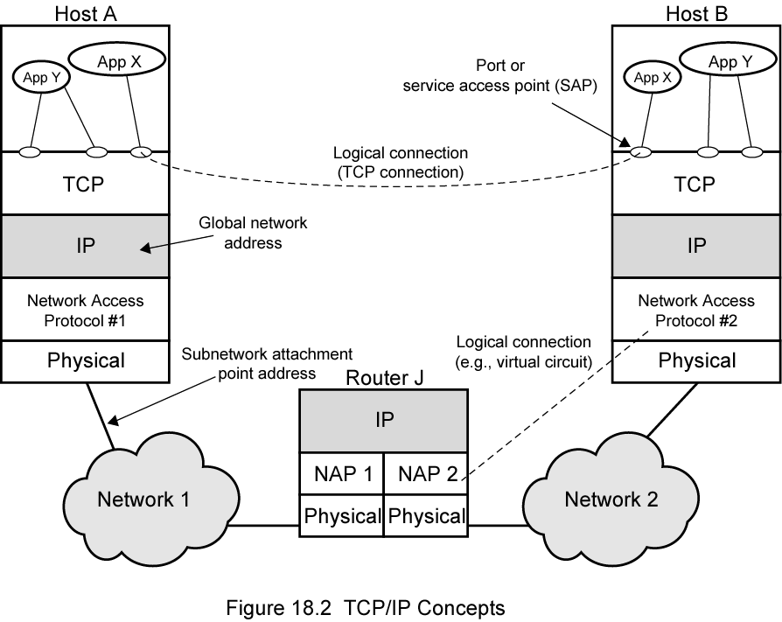
TCP/IP Concepts

Slide 18
Addressing Level
Level in comms architecture at which entity is named
Unique address for each end system
  e.g. workstation or server
And each intermediate system
  (e.g., router)
Network-level address
  IP address or internet address
  OSI - network service access point (NSAP)
  Used to route PDU through network
At destination data must routed to some process
  Each process assigned an identifier
  TCP/IP port
  Service access point (SAP) in OSI

Slide 19
Addressing Scope
Global address
  Global nonambiguity
  Identifies unique system
  Synonyms permitted
  System may have more than one global address
  Global applicability
  Possible at any global address to identify any other global address, in any system, by means of global address of other system
  Enables internet to route data between any two systems
Need unique address for each device interface on network
  MAC address on IEEE 802 network and ATM host address
  Enables network to route data units through network and deliver to intended system
  Network attachment point address
Addressing scope only relevant for network-level addresses
Port or SAP above network level is unique within system
  Need not be globally unique
  E.g port 80 web server listening port in TCP/IP

Slide 20
Connection Identifiers
Entity 1 on system A requests connection to entity 2 on system B, using global address B.2.
B.2 accepts connection
Connection identifier used by both entities for future transmissions
Reduced overhead
  Generally shorter than global identifiers
Routing
  Fixed route may be defined
  Connection identifier identifies route to intermediate systems
Multiplexing
  Entity may wish more than one connection simultaneously
  PDUs must be identified by connection identifier
Use of state information
Once connection established, end systems can maintain state information about connection
  Flow and error control using sequence numbers

Slide 21
Addressing Mode
Usually address refers to single system or port
  Individual or unicast address
Address can refer to more than one entity or port
  Multiple simultaneous recipients for data
  Broadcast for all entities within domain
  Multicast for specific subset of entities

Slide 22
Multiplexing
Multiple connections into single system
  E.g. frame relay, can have multiple data link connections terminating in single end system
  Connections multiplexed over single physical interface
Can also be accomplished via port names
  Also permit multiple simultaneous connections
  E.g. multiple TCP connections to given system
    Each connection on different pair of ports

Slide 23
Multiplexing Between Levels
Upward or inward multiplexing
  Multiple higher-level connections share single lower-level connection
    More efficient use of lower-level service
    Provides several higher-level connections where only single lower-level connection exists
Downward multiplexing, or splitting
  Higher-level connection built on top of multiple lower-level connections
  Traffic on higher connection divided among lower connections
    Reliability, performance, or efficiency.

Slide 24
Transmission Services
Protocol may provide additional services to entities
E.g.:
Priority
  Connection basis
  On message basis
    E.g. terminate-connection request
Quality of service
  E.g. minimum throughput or maximum delay threshold
Security
  Security mechanisms, restricting access
These services depend on underlying transmission system and lower-level entities

Slide 25
Internetworking Terms (1)
Communications Network
  Facility that provides data transfer service
An internet
  Collection of communications networks interconnected by bridges and/or routers
The Internet - note upper case I
  The global collection of thousands of individual machines and networks
Intranet
  Corporate internet operating within the organization
  Uses Internet (TCP/IP and http)technology to deliver documents and resources

Slide 26
Internetworking Terms (2)
End System (ES)
  Device attached to one of the networks of an internet
  Supports end-user applications or services
Intermediate System (IS)
  Device used to connect two networks
  Permits communication between end systems attached to different networks

Slide 27
Internetworking Terms (3)
Bridge
  IS used to connect two LANs using similar LAN protocols
  Address filter passing on packets to the required network only
  OSI layer 2 (Data Link)
Router
  Connects two (possibly dissimilar) networks
  Uses internet protocol present in each router and end system
  OSI Layer 3 (Network)

Slide 28
Requirements of Internetworking
Link between networks
  Minimum physical and link layer
Routing and delivery of data between processes on different networks
Accounting services and status info
Independent of network architectures

Slide 29
Network Architecture Features
Addressing
Packet size
Access mechanism
Timeouts
Error recovery
Status reporting
Routing
User access control
Connection based or connectionless

Slide 30
Architectural Approaches
Connection oriented
Connectionless

Slide 31
Connection Oriented
Assume that each network is connection oriented
IS connect two or more networks
  IS appear as ES to each network
  Logical connection set up between ESs
    Concatenation of logical connections across networks
  Individual network virtual circuits joined by IS
May require enhancement of local network services
  802, FDDI are datagram services

Slide 32
Connection Oriented IS Functions
Relaying
Routing
e.g. X.75 used to interconnect X.25 packet switched networks
Connection oriented not often used
  (IP dominant)

Slide 33
Connectionless Operation
Corresponds to datagram mechanism in packet switched network
Each NPDU treated separately
Network layer protocol common to all DTEs and routers
  Known generically as the internet protocol
Internet Protocol
  One such internet protocol developed for ARPANET
  RFC 791 (Get it and study it)
Lower layer protocol needed to access particular network

Slide 34
Connectionless Internetworking
Advantages
  Flexibility
  Robust
  No unnecessary overhead
Unreliable
  Not guaranteed delivery
  Not guaranteed order of delivery
    Packets can take different routes
  Reliability is responsibility of next layer up (e.g. TCP)

Slide 35
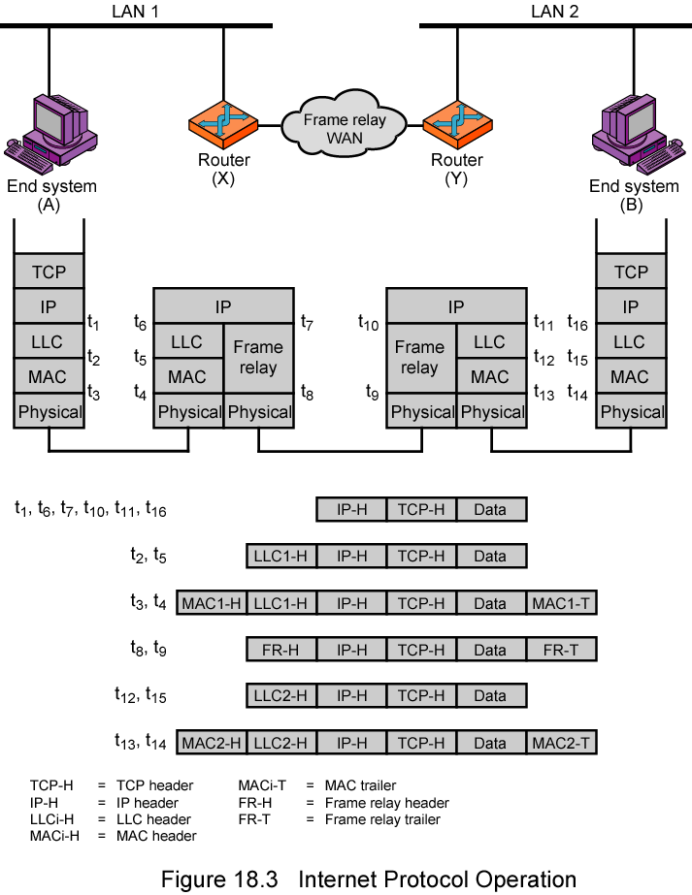
IP Operation

Slide 36
Design Issues
Routing
Datagram lifetime
Fragmentation and re-assembly
Error control
Flow control

Slide 37
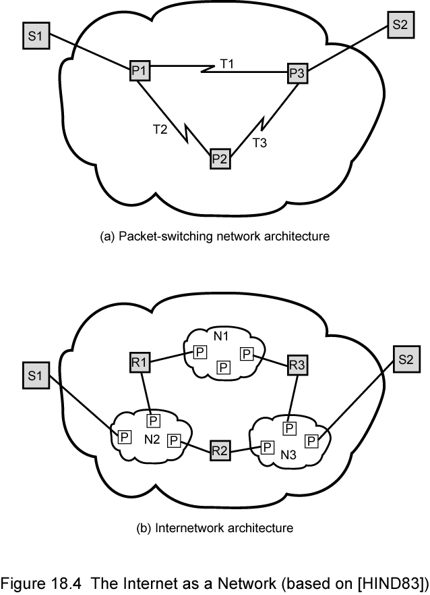
The Internet as a Network

Slide 38
Routing
End systems and routers maintain routing tables
  Indicate next router to which datagram should be sent
  Static
    May contain alternative routes
  Dynamic
    Flexible response to congestion and errors
Source routing
  Source specifies route as sequential list of routers to be followed
  Security
  Priority
Route recording

Slide 39
Datagram Lifetime
Datagrams could loop indefinitely
  Consumes resources
  Transport protocol may need upper bound on datagram life
Datagram marked with lifetime
  Time To Live field in IP
  Once lifetime expires, datagram discarded (not forwarded)
  Hop count
    Decrement time to live on passing through a each router
  Time count
    Need to know how long since last router
(Aside: compare with Logan’s Run)

Slide 40
Fragmentation and
Re-assembly
Different packet sizes
When to re-assemble
  At destination
    Results in packets getting smaller as data traverses internet
  Intermediate re-assembly
    Need large buffers at routers
    Buffers may fill with fragments
    All fragments must go through same router
      Inhibits dynamic routing

Slide 41
IP Fragmentation (1)
IP re-assembles at destination only
Uses fields in header
  Data Unit Identifier (ID)
    Identifies end system originated datagram
      Source and destination address
      Protocol layer generating data (e.g. TCP)
      Identification supplied by that layer
  Data length
    Length of user data in octets

Slide 42
IP Fragmentation (2)
  Offset
    Position of fragment of user data in original datagram
    In multiples of 64 bits (8 octets)
  More flag
    Indicates that this is not the last fragment

Slide 43
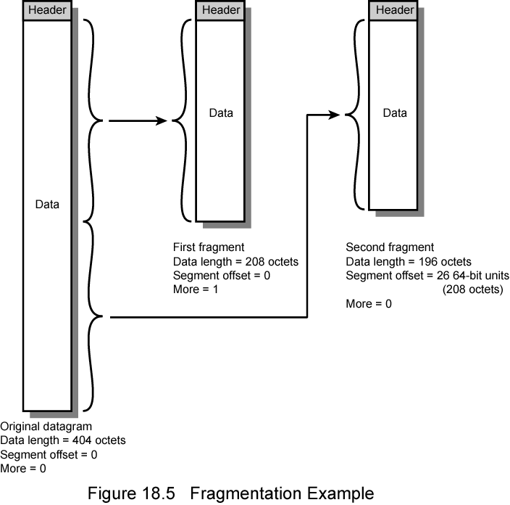
Fragmentation Example

Slide 44
Dealing with Failure
Re-assembly may fail if some fragments get lost
Need to detect failure
Re-assembly time out
  Assigned to first fragment to arrive
  If timeout expires before all fragments arrive, discard partial data
Use packet lifetime (time to live in IP)
  If time to live runs out, kill partial data

Slide 45
Error Control
Not guaranteed delivery
Router should attempt to inform source if packet discarded
  e.g. for time to live expiring
Source may modify transmission strategy
May inform high layer protocol
Datagram identification needed
(Look up ICMP)

Slide 46
Flow Control
Allows routers and/or stations to limit rate of incoming data
Limited in connectionless systems
Send flow control packets
  Requesting reduced flow
e.g. ICMP

Slide 47
Internet Protocol (IP) Version 4
Part of TCP/IP
  Used by the Internet
Specifies interface with higher layer
  e.g. TCP
Specifies protocol format and mechanisms
RFC 791
  Get it and study it!
  www.rfc-editor.org
Will (eventually) be replaced by IPv6 (see later)

Slide 48
IP Services
Primitives
  Functions to be performed
  Form of primitive implementation dependent
    e.g. subroutine call
  Send
    Request transmission of data unit
  Deliver
    Notify user of arrival of data unit
Parameters
  Used to pass data and control info

Slide 49
Parameters (1)
Source address
Destination address
Protocol
  Recipient e.g. TCP
Type of Service
  Specify treatment of data unit during transmission through networks
Identification
  Source, destination address and user protocol
  Uniquely identifies PDU
  Needed for re-assembly and error reporting
  Send only

Slide 50
Parameters (2)
Don’t fragment indicator
  Can IP fragment data
  If not, may not be possible to deliver
  Send only
Time to live
  Send only
Data length
Option data
User data

Slide 51
Options
Security
Source routing
Route recording
Stream identification
Timestamping

Slide 52
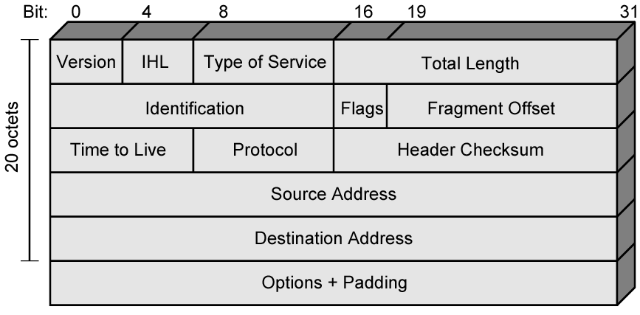
IPv4 Header

Slide 53
Header Fields (1)
Version
  Currently 4
  IP v6 - see later
Internet header length
  In 32 bit words
  Including options
Type of service
Total length
  Of datagram, in octets

Slide 54
Header Fields (2)
Identification
  Sequence number
  Used with addresses and user protocol to identify datagram uniquely
Flags
  More bit
  Don’t fragment
Fragmentation offset
Time to live
Protocol
  Next higher layer to receive data field at destination

Slide 55
Header Fields (3)
Header checksum
  Reverified and recomputed at each router
  16 bit ones complement sum of all 16 bit words in header
  Set to zero during calculation
Source address
Destination address
Options
Padding
  To fill to multiple of 32 bits long

Slide 56
Data Field
Carries user data from next layer up
Integer multiple of 8 bits long (octet)
Max length of datagram (header plus data) 65,535 octets

Slide 57
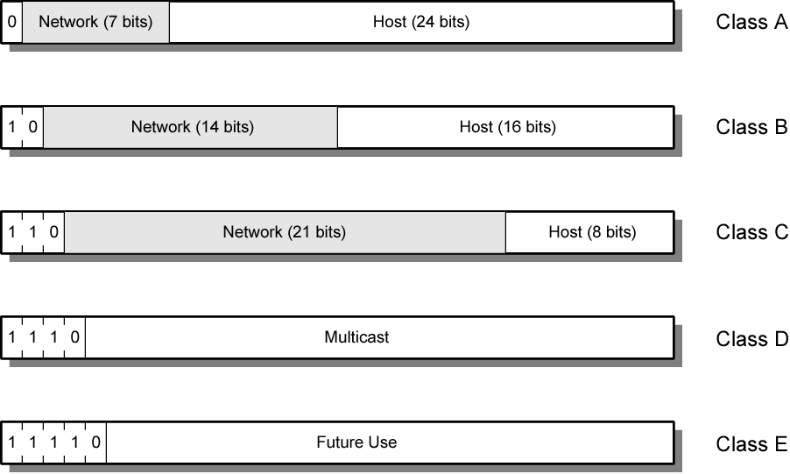
IPv4 Address Formats

Slide 58
IP Addresses - Class A
32 bit global internet address
Network part and host part
Class A
  Start with binary 0
  All 0 reserved
  01111111 (127) reserved for loopback
  Range 1.x.x.x to 126.x.x.x
  All allocated

Slide 59
IP Addresses - Class B
Start 10
Range 128.x.x.x to 191.x.x.x
Second Octet also included in network address
2¹⁴ = 16,384 class B addresses
All allocated

Slide 60
IP Addresses - Class C
Start 110
Range 192.x.x.x to 223.x.x.x
Second and third octet also part of network address
2²¹ = 2,097,152 addresses
Nearly all allocated
  See IPv6

Slide 61
Subnets and Subnet Masks
Allow arbitrary complexity of internetworked LANs within organization
Insulate overall internet from growth of network numbers and routing complexity
Site looks to rest of internet like single network
Each LAN assigned subnet number
Host portion of address partitioned into subnet number and host number
Local routers route within subnetted network
Subnet mask indicates which bits are subnet number and which are host number

Slide 62
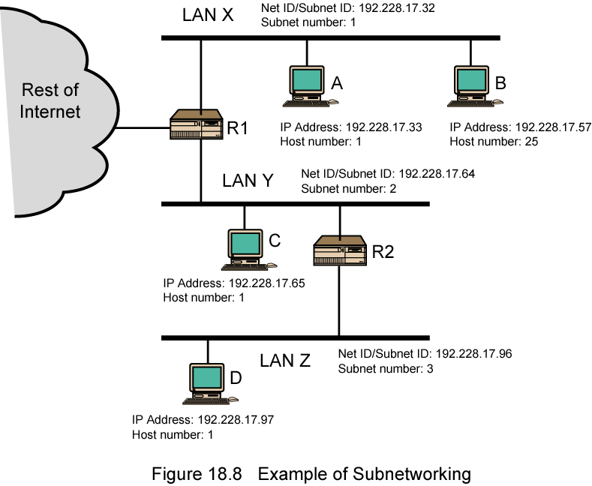
Routing Using Subnets

Slide 63
ICMP
Internet Control Message Protocol
RFC 792 (get it and study it)
Transfer of (control) messages from routers and hosts to hosts
Feedback about problems
  e.g. time to live expired
Encapsulated in IP datagram
  Not reliable

Slide 64
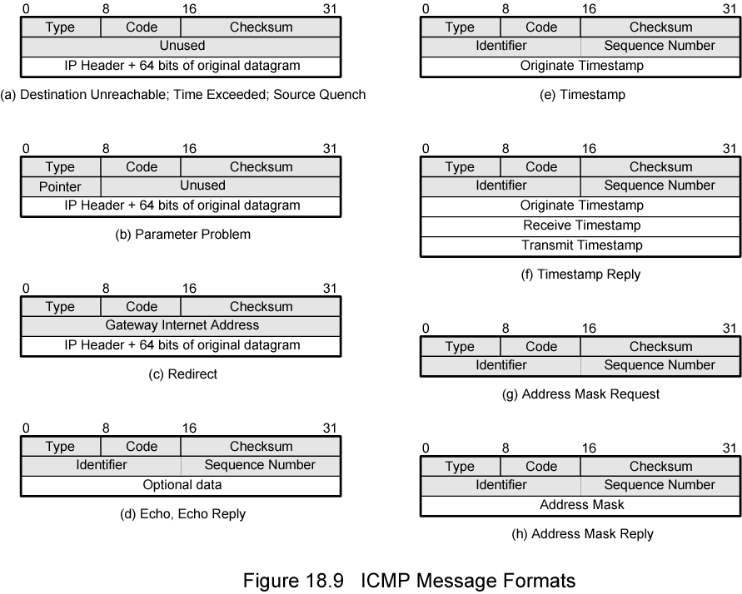
ICMP Message Formats

Slide 65
IP v6 - Version Number
IP v 1-3 defined and replaced
IP v4 - current version
IP v5 - streams protocol
IP v6 - replacement for IP v4
  During development it was called IPng
  Next Generation

Slide 66
Why Change IP?
Address space exhaustion
  Two level addressing (network and host) wastes space
  Network addresses used even if not connected to Internet
  Growth of networks and the Internet
  Extended use of TCP/IP
  Single address per host
Requirements for new types of service

Slide 67
IPv6 RFCs
1752 - Recommendations for the IP Next Generation Protocol
2460 - Overall specification
2373 - addressing structure
others (find them)
www.rfc-editor.org

Slide 68
IPv6 Enhancements (1)
Expanded address space
  128 bit
Improved option mechanism
  Separate optional headers between IPv6 header and transport layer header
  Most are not examined by intermediate routes
    Improved speed and simplified router processing
    Easier to extend options
Address autoconfiguration
  Dynamic assignment of addresses

Slide 69
IPv6 Enhancements (2)
Increased addressing flexibility
  Anycast - delivered to one of a set of nodes
  Improved scalability of multicast addresses
Support for resource allocation
  Replaces type of service
  Labeling of packets to particular traffic flow
  Allows special handling
  e.g. real time video

Slide 70
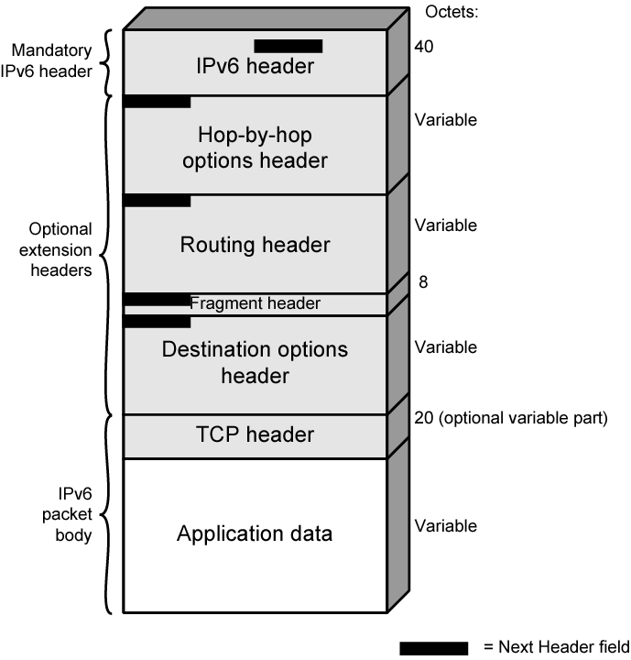
IPv6
Structure

Slide 71
Extension Headers
Hop-by-Hop Options
  Require processing at each router
Routing
  Similar to v4 source routing
Fragment
Authentication
Encapsulating security payload
Destination options
  For destination node

Slide 72
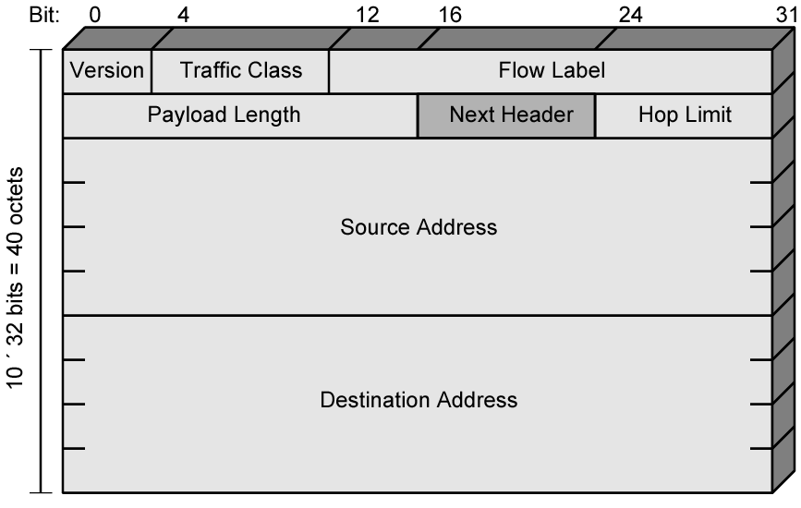
IP v6 Header

Slide 73
IP v6 Header Fields (1)
Version
  6
Traffic Class
  Classes or priorities of packet
  Still under development
  See RFC 2460
Flow Label
  Used by hosts requesting special handling
Payload length
  Includes all extension headers plus user data

Slide 74
IP v6 Header Fields (2)
Next Header
  Identifies type of header
    Extension or next layer up
Source Address
Destination address

Slide 75
IPv6 Addresses
128 bits long
Assigned to interface
Single interface may have multiple unicast addresses
Three types of address

Slide 76
Types of address
Unicast
  Single interface
Anycast
  Set of interfaces (typically different nodes)
  Delivered to any one interface
  the “nearest”
Multicast
  Set of interfaces
  Delivered to all interfaces identified

Slide 77
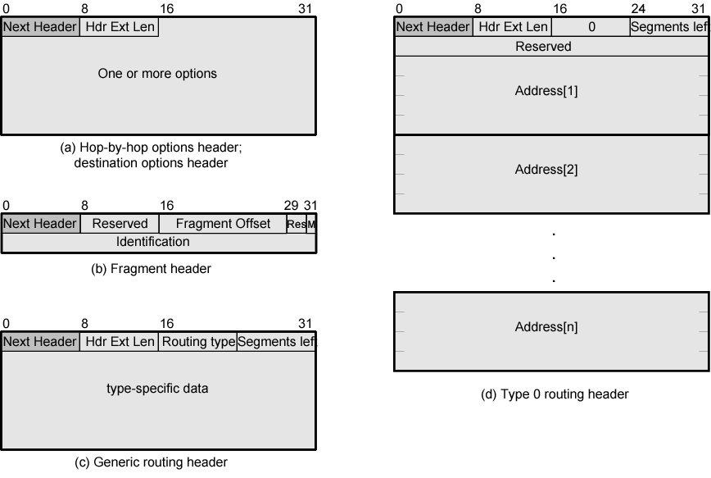
IPv6 Extension Headers

Slide 78
Hop-by-Hop Options
Next header
Header extension length
Options
  Pad1
    Insert one byte of padding into Options area of header
  PadN
    Insert N (≥2) bytes of padding into Options area of header
    Ensure header is multiple of 8 bytes
  Jumbo payload
    Over 2¹⁶ = 65,535 octets
  Router alert
    Tells router that contents of packet is of interest to router
    Provides support for RSPV (chapter 16)

Slide 79
Fragmentation Header
Fragmentation only allowed at source
No fragmentation at intermediate routers
Node must perform path discovery to find smallest MTU of intermediate networks
Source fragments to match MTU
Otherwise limit to 1280 octets

Slide 80
Fragmentation Header Fields
Next Header
Reserved
Fragmentation offset
Reserved
More flag
Identification

Slide 81
Routing Header
List of one or more intermediate nodes to be visited
Next Header
Header extension length
Routing type
Segments left
  i.e. number of nodes still to be visited

Slide 82
Destination Options
Same format as Hop-by-Hop options header

Slide 83
Required Reading
Stallings chapter 18
Comer, S. Internetworking with TCP/IP,
volume 1, Prentice-Hall
All RFCs mentioned plus any others connected with these topics
  www.rfc-editor.org
Loads of Web sites on TCP/IP and IP version 6

